Slide 1


PHARMACOGENINSIGHT
Leveraging Genetics for Personalized Medicine

Slide 2
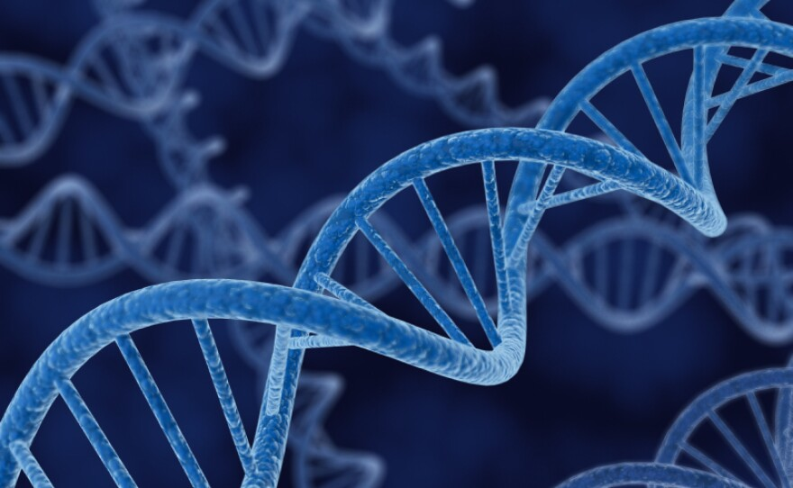

Abstract
Pharmacogeninsight is a comprehensive database project designed to optimize drug prescriptions through genetic information. By integrating data on patients, genetic variants, drugs, and treatment responses, this project aims to improve personalized treatment plans and outcomes. Key tables include Patients, GeneticVariants, Drugs, PatientVariants, Treatments, and Responses. These interconnected tables allow for the analysis of genetic factors influencing drug efficacy and safety, ultimately enhancing patient care by reducing adverse reactions and tailoring therapies to individual genetic profiles.

Slide 3
ER DIAGRAM

Slide 4
STRUCTURE OF TABLE
PATIENT TABLE
Stores patient information such as names and contact details.
SYNTAX: Desc patient;

Slide 5
STRUCTURE OF TABLE
Geneticvariants TABLE
This table holds data on specific gene variants and their impacts, with each variant
SYNTAX: Desc geneticvariants;

Slide 6
STRUCTURE OF TABLE
Drug TABLE
This table includes details about various medications, such as their classes, indications, contraindications, dosages, and side effects.
SYNTAX: Desc drug;

Slide 7
STRUCTURE OF TABLE
PatientVariants TABLE
This is a linking table that connects patients to their genetic variants using patient_id and variant_id. It captures the many-to-many relationship, showing which genetic variants are present in each patient.
SYNTAX: Desc Patientvariant;

Slide 8
STRUCTURE OF TABLE
Treatments TABLE
This table records the drugs prescribed to patients, along with the start and end dates of the treatment. It uses patient_id and drug_id to establish the relationship between patients and their prescribed drugs.
SYNTAX: Desc Treatments;

Slide 9
STRUCTURE OF TABLE
Responses TABLE
This table captures the effectiveness and side effects of the treatments. It also uses patient_id and drug_id to link the patient's response to a specific treatment.
SYNTAX: Desc Responses;

Slide 10
CONTENTS OF TABLE PATIENTS

Slide 11
CONTENTS OF TABLE GENETICVARIANTS

Slide 12
CONTENTS OF TABLE DRUG

Slide 13
CONTENTS OF TABLE PATIENTVARIANTS

Slide 14
CONTENTS OF TABLE TREATMENTS

Slide 15
CONTENTS OF TABLE RESPONSES

Slide 16

SUB QUERIES

Slide 17
SUB QUERY
Find patients whose genetic variants are associated with high impact
SYNTAX: SELECT patient_id, name
FROM Patients
WHERE patient_id IN (SELECT patient_id
FROM PatientVariants WHERE variant_id IN (
SELECT variant_id FROM GeneticVariants WHERE impact = 'High' ));

Slide 18
SUB QUERY
Find the names of patients who have variants associated with the gene 'ACE':
SYNTAX: SELECT name FROM Patients WHERE patient_id IN ( SELECT patient_id FROM PatientVariants WHERE variant_id IN ( SELECT variant_id FROM GeneticVariants WHERE gene = 'AGT' ));

Slide 19
SUB QUERY
Find patients who have taken drugs but have never had a completely effective response:
SYNTAX: SELECT patient_id, name FROM Patients WHERE patient_id IN ( SELECT DISTINCT patient_id FROM Treatments) AND patient_id NOT IN (SELECT patient_id FROM Responses WHERE effectiveness = 'Effective');

Slide 20
SUB QUERY
Find the patients who have taken a drug and had a response within 7 days of starting the treatment:
SYNTAX:
SELECT patient_id, name FROM Patients WHERE patient_id IN ( SELECT patient_id FROM Treatments WHERE treatment_id IN ( SELECT T.treatment_id FROM Treatments T, Responses R WHERE T.patient_id = R.patient_id AND T.drug_id = R.drug_id AND DATEDIFF(R.response_date, T.start_date) <= 7 ));

Slide 21
SUB QUERY
Find patients who have responded with "Not Effective" to treatment:
SYNTAX:
SELECT patient_id, name
FROM Patients
WHERE patient_id IN (
SELECT DISTINCT patient_id
FROM Responses
WHERE effectiveness = 'Not Effective'
);

Slide 22
JOINS

Slide 23
JOINS
Find patients who have been prescribed drugs indicated for diabetes:
SYNTAX:
SELECT DISTINCT P.patient_id, P.name
FROM Patients P
JOIN Treatments T ON P.patient_id = T.patient_id
JOIN Drug D ON T.drug_id = D.drug_id
WHERE D.indications LIKE '%diabetes%';

Slide 24
JOINS
List all patients along with their prescribed drug names and their genetic variants:
SYNTAX:
SELECT P.name, D.drug_name, GV.gene, GV.variant
FROM Patients P
JOIN Treatments T ON P.patient_id = T.patient_id
JOIN Drug D ON T.drug_id = D.drug_id
JOIN PatientVariants PV ON P.patient_id = PV.patient_id
JOIN GeneticVariants GV ON PV.variant_id = GV.variant_id;

Slide 25
JOINS
Find the total number of patients treated with each drug:
SYNTAX:
SELECT D.drug_name, COUNT(DISTINCT T.patient_id) AS total_patients
FROM Drug D
JOIN Treatments T ON D.drug_id = T.drug_id
GROUP BY D.drug_name;

Slide 26
JOINS
List the genetic variants of each patient along with their responses to treatments:
SYNTAX:
SELECT P.name, GV.gene, GV.variant, R.effectiveness, R.side_effects
FROM Patients P
JOIN PatientVariants PV ON P.patient_id = PV.patient_id
JOIN GeneticVariants GV ON PV.variant_id = GV.variant_id
JOIN Responses R ON P.patient_id = R.patient_id;

Slide 27
JOINS
To calculate the average effectiveness score for each medical condition based on the indications of the drugs:
SYNTAX:
SELECT D.indications, AVG(CASE WHEN R.effectiveness = 'Effective' THEN 3
WHEN R.effectiveness = 'Moderately Effective' THEN 2
WHEN R.effectiveness = 'Not Effective' THEN 1 ELSE 0 END) AS average_effectiveness_score FROM Drug D
JOIN Treatments T ON D.drug_id = T.drug_id
JOIN Responses R ON T.patient_id = R.patient_id AND T.drug_id = R.drug_id
GROUP BY D.indications
ORDER BY average_effectiveness_score DESC;

Slide 28
THANK YOU
PRESENTED BY:
DEEKSHA PUTHRAN

